Slide 1
An Information Theoretic Analysis of Grid Cell Encoding
May 13, 2022
Ariel K. Feldman

Slide 2
How do we evaluate codes found in nature?

Slide 3
Defining a Code
Encoders
Message
Noisy Channel
Decoder

Slide 4
$$H\left(X_{1} | X_{2}\right)=−\sum_{x∈X_{2}}{p\left(x\right)} H(X_{1}|X_{2}=x)$$
Conditional Entropy
Measures average uncertainty
Predictivity of neural activity
Coarse grained measure over many sources
H(X₁|X₂)
MI(X1;X2)
H(X₂|X₁)
H(X₁)
H(X₂)

Slide 5
Partial Information Decomposition (PID)
MI(M: (X₁ , X₂))
SI(M: X₁ , X₂)
Interpretable, fine-grained measure of information between sources
M, X₁ and X₂ have finite state spaces
All 4 information quantities are non-negative
UI(M: X₁ \ X₂)
RI(M: X₁ , X₂)
UI(M: X₂ \ X₁)

Slide 6
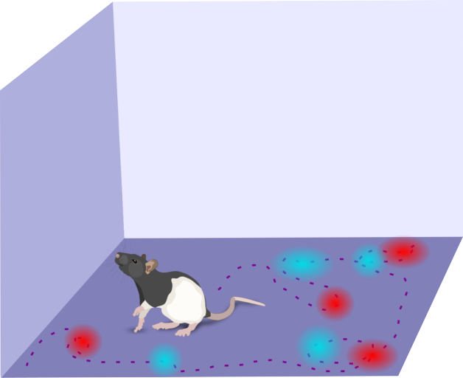
A Case Study in Grid Cells
Distributed source coding
Uninformative on their own
Discretizing relates PID to conditional entropy
Grid Cell 1
Grid Cell 2
Rodent art credit: Etienne Ackermann

Slide 7
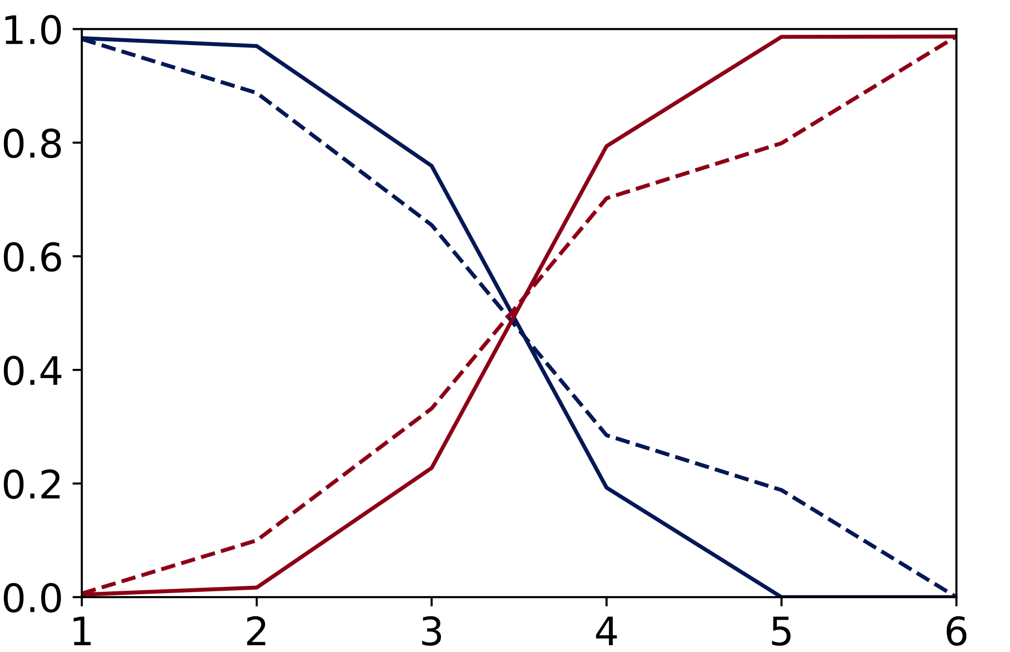
Unique & Redundant Information Trade-off
Simulated Efficient Error-Correcting Grid Codes
Steeper slopes indicate higher encoding efficiency
Average Information (Bits)
H. Redundant
H. ← Hamming Code
L.E. ← Less Efficient Code
L.E. Redundant
MI(M: (X₁ , X₂))
SI(M: X₁ , X₂)
L.E. Unique
UI(M: X₁ \ X₂)
RI(M: X₁ , X₂)
UI(M: X₂ \ X₁)
H. Unique
Cardinality

Slide 8
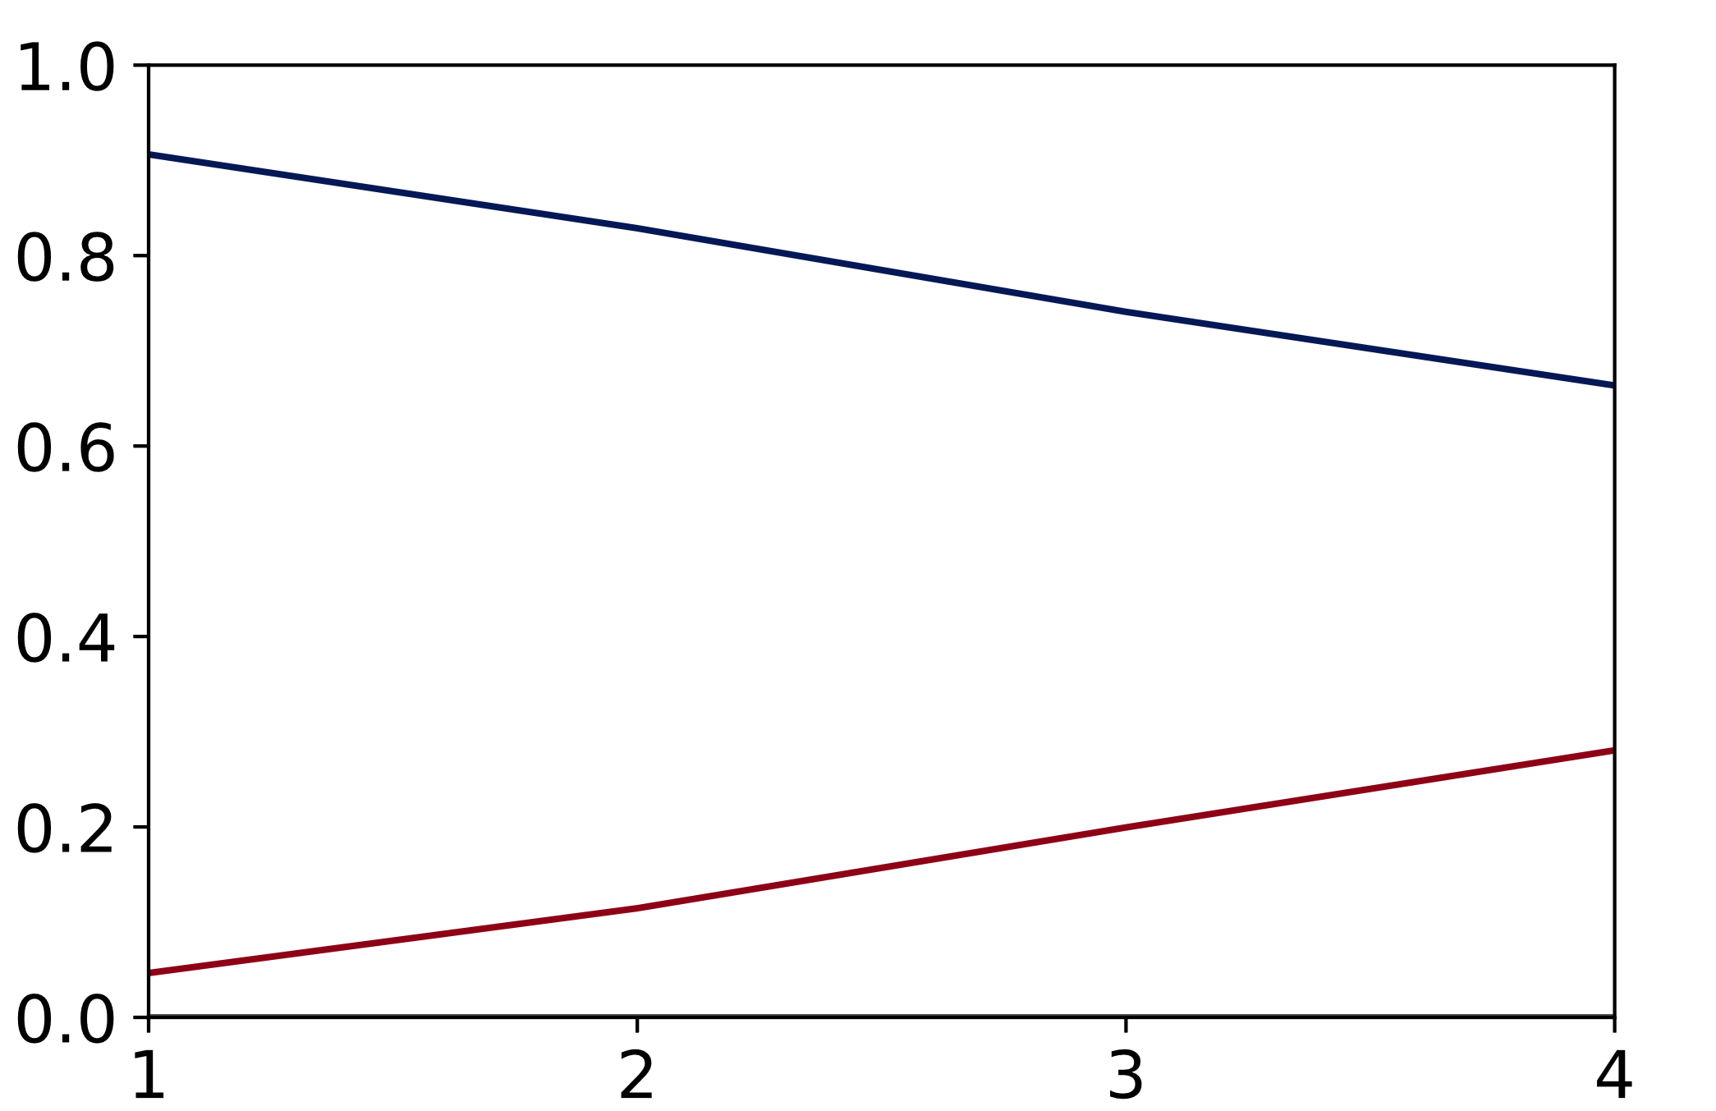
Unique & Redundant Information Trade-off
PID on Real Grid Cells
Average Information (Bits)
Slow rise/fall in redundant and unique information values
Unique
MI(M: (X₁ , X₂))
SI(M: X₁ , X₂)
Redundant
Synergistic
UI(M: X₁ \ X₂)
RI(M: X₁ , X₂)
UI(M: X₂ \ X₁)
Cardinality

Slide 9
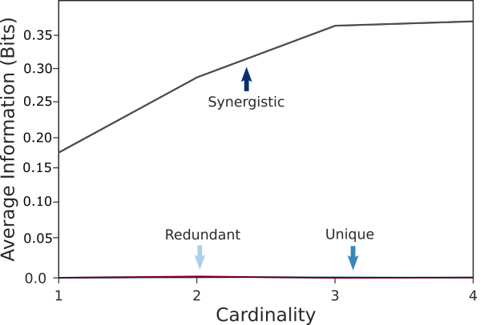
Crude Information
PID on Real Grid Cells
Average Information (Bits)
Synergistic
MI(M: (X₁ , X₂))
SI(M: X₁ , X₂)
UI(M: X₁ \ X₂)
RI(M: X₁ , X₂)
UI(M: X₂ \ X₁)
Unique
Redundant
Cardinality

Slide 10
PID is a Good Metric for Neural Representations
Values match expectations when applied to grid cell data
Identifies distribution of information among sources (grid cells)
Interpretable and more informative than other measures (i.e. conditional entropy)

Slide 11
Acknowledgments
arielfeldman@cmu.edu
@neuRELengineer
arielfeldman.github.io
Pulkit Grover
Doug Weber
Praveen Venkatesh
Data from Trettel et al. https://doi.org/10.6084/m9.figshare.c.4496375

Slide 12
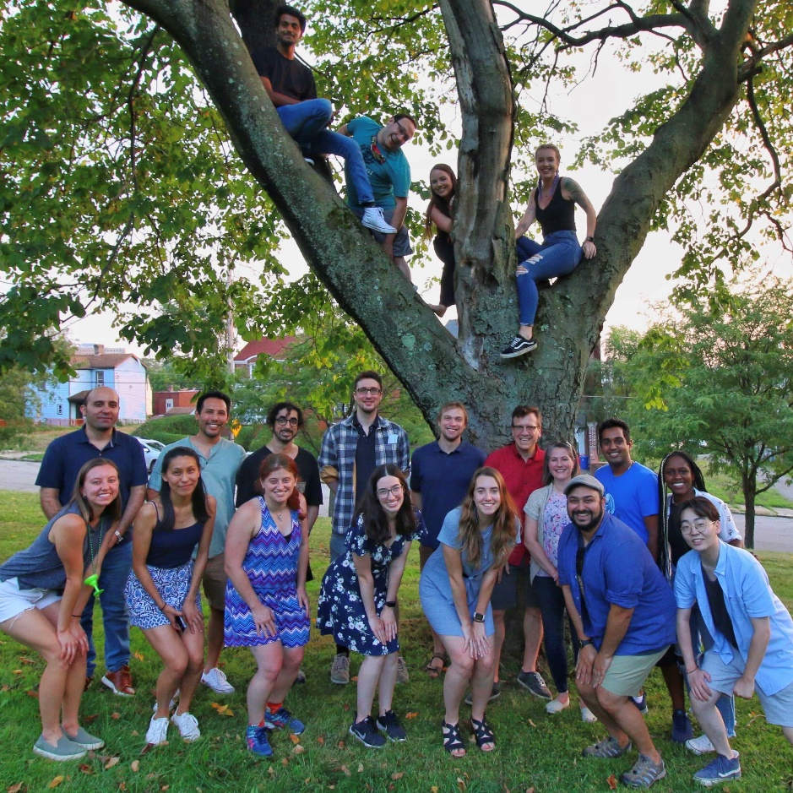
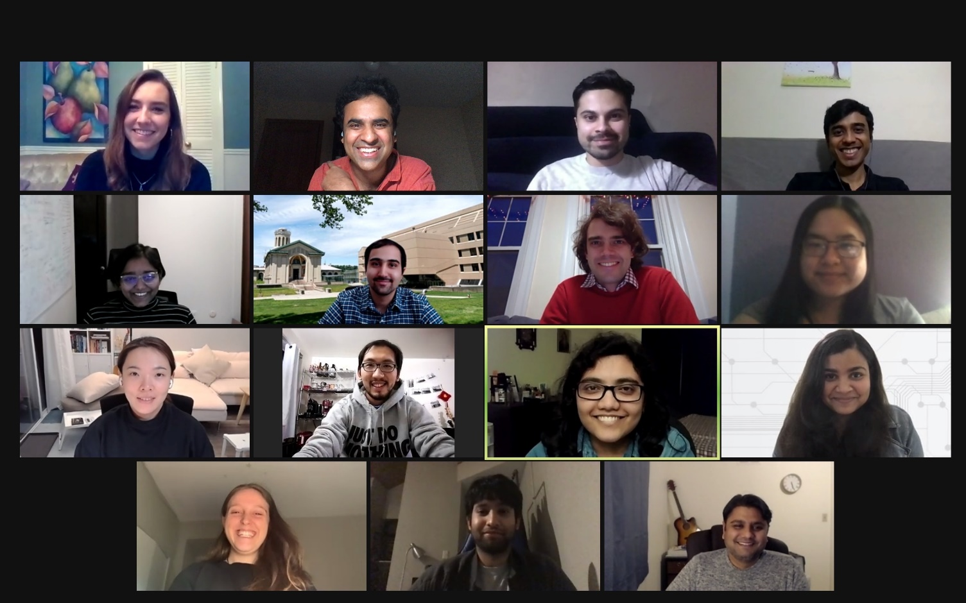
Acknowledgments
arielfeldman@cmu.edu
@neuRELengineer
arielfeldman.github.io
NeuroMechatronics Lab
Doug Weber
Grover Lab
Pulkit Grover

Slide 13
Hamming(7,4) Code

Slide 14
Williams & Beer
Mis-attributes unique information as redundant
Breaks down when redundant information is 0
2 independent grid cells would have 1 bit of redundant information, no unique information. However, intuition suggests otherwise.

